Slide 1



THE ROLE OF AUDIT
©University of Cape Town
All rights reserved
Note: These materials are for educational purposes and for your personal use and may not be shared, distributed, sold or placed on any third-party websites without the permission of the University.

Slide 2

LEARNING OUTCOMES
AT THE END OF THE WEEK, YOU SHOULD BE ABLE TO ANSWER THE FOLLOWING:
What is the purpose of an audit?
What role does management play in the audit process?
What is the difference between an external and internal auditor?
Which entities should be audited?
What are the benefits and limitations of an audit?

Slide 3
The purpose of an audit
ACCOUNTING RECORDS
FINANCIAL STATEMENTS
FINANCIAL REPORTING

Slide 4

The purpose of an audit
Issued to keep track of an order received from a customer
Issued when goods are delivered to customers as proof of delivery
Issued to inform the customer of the amount that is due for the goods supplied
Sales order
Delivery note
Sales invoice
Sales journal
General ledger
Trial balance
Financial statements
The GL balances are transferred to the TB...
The total of the sales invoices recorded is transferred to the GL
Transaction recorded in the sales journal/debtors ledger from the sales invoice
...and used as a basis to prepare the financial statements

Slide 5



The purpose of an audit
Management is responsible for preparing the financial statements, which includes:
Statement of Financial Position;
Statement of Comprehensive Income;
Statement of Changes in Equity;
Statement of Cash Flows; and
All notes to the Financial Statements
Prepared by the accounting department, with oversight by the Chief Financial Officer
Approved by the board of directors

Slide 6
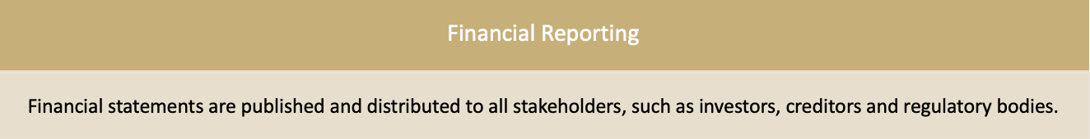
The purpose of an audit
Shareholders
Directors
Directors report on their management of the company, using financial statements.
Can we trust what directors say at face value?

Slide 7
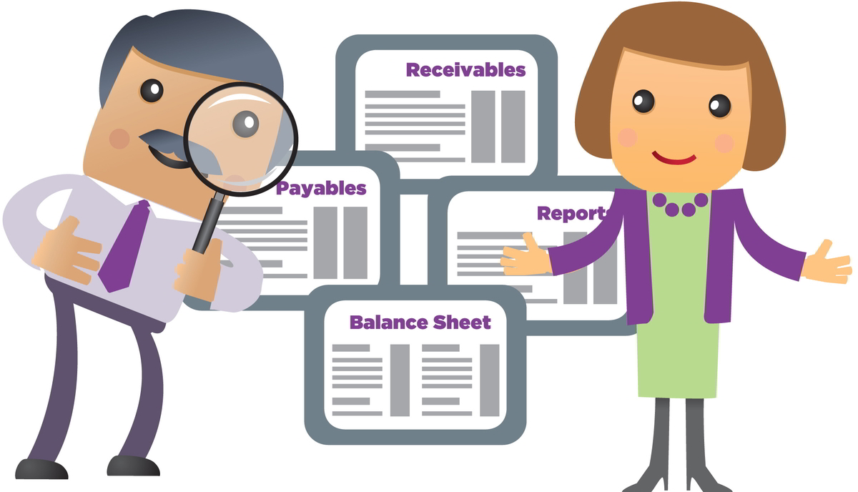
What is an audit?

Slide 8
What is an audit?
“The purpose of an audit is to enhance the degree of confidence of the intended users in the financial statements. This is achieved by the expression of an opinion by the auditor”
Source: ISA 200:3

Slide 9
What is an audit?
Types of Audit
Internal Audit
External Audit
Performed by the internal audit department
Responsible for assessing the risks in the company
Consider management objectives, risks and controls
Employed by the company
Performed by independent auditors
Systematically obtain and consider evidence and information objectively about economic actions and events and assess whether these have been appropriately presented and disclosed in the financial statements
Not an employee of the company

Slide 10
Entities subject to an audit
All state-owned companies
All public companies
Public interest score
Private companies deemed to have a high level of public interest
Voluntary audit
Hold assets in fiduciary capacity exceeding R5 million
What is their impact on the broader South African public?

Slide 11
Public Interest Score (PI)
A PI Score is a score that determines your company’s public interest. This score is important because the Companies Act requires all companies to calculate their PI Scores
Depending on your PI score it will:
determine the type of AFS that your company should prepare (audited or independently reviewed)
The financial reporting standards that apply to your company (IFRS, IFRS for SMMEs or SA GAAP)

Slide 12
Calculating Public Interest Score (PI)
1 point for every employee (equal to the average number of employees during the financial year)
1 point for every R1 million of third party liability at the end of the financial year (third party liability means debts outstanding, creditors, instalment sales, etc. owing to outside parties)
1 point for every R1 million of turnover (or portion thereof) during the financial year
1 point for every individual with a beneficial interest in the company’s securities (if a for-profit company) and in the case of a non-profit company, 1 point for every member of the company (or who is a member of an association that is a member of the company).

Slide 13
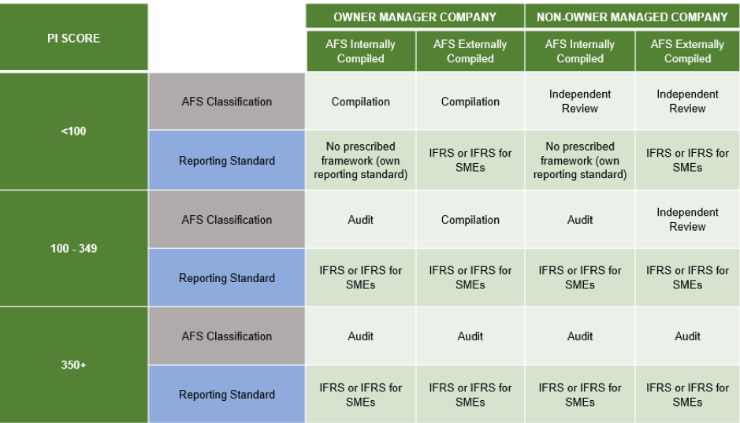
Calculating Public Interest Score (PI)

Slide 14
Types of audit reports
Type of audit opinions | Explanation
Unqualified (clean audit) | AFS are free of material misstatement
Qualified | AFS overall are free of material misstatement, other than specific material misstatements that were identified in the AFS.
Adverse | Pervasive material misstatement throughout the AFS
Disclaimer | Unable to express an audit opinion due to limitation of scope, significant uncertainty, auditor’s independence compromised.

Slide 15
Types of audit reports- examples
Unqualified opinion In our opinion, the consolidated and separate annual financial statements present fairly, in all material respects. | Qualified opinion In our opinion, except for the effects of the matter described in the Basis for qualified opinion section of our report, the consolidated and separate annual financial statements present fairly, in all material respects, the consolidated and separate financial position of the group and company as at 30 June 2020, and its consolidated and separate financial performance and consolidated and separate cash flows for the year then ended in accordance with International Financial Reporting Standards and the requirements of the Companies Act of South Africa
Adverse opinion In our opinion, because of the significance of the matter described in the Basis for Adverse Opinion section of our report, the Consolidated and Separate Financial Statements do not present fairly the financial position. | Disclaimer of Opinion We do not express an opinion on the financial statements of the company because of the significance of the matters described in the Basis for Disclaimer of Opinion section of our report, we have not been able to obtain sufficient appropriate audit evidence on going concern to provide a basis for an audit opinion on these financial statements.

Slide 16
Benefits of an audit
Benefits of an Audit
Financial statements are more readily accepted as reliable by third-party users (e.g., Banks)
The audit process acts as a fraud deterrent for employees in the organisation
SARS accepts audited financial statements when reviewing tax calculations and tax return submissions
Audited financial statements provide a reliable basis for company valuations
The auditors’ knowledge of business and advice can lead to greater efficiencies and improved performance

Slide 17



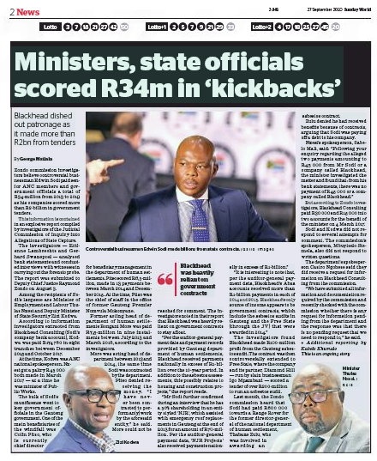

Limitations of an audit

Slide 18
Limitations of an audit
The nature of financial reporting
Involves judgement and estimates made by management (e.g., Depreciation - useful life, residual value, etc.)
The nature of audit evidence
Audits are conducted on a sample basis
Other factors
The quality of the audit is dependent on the quality of the evidence provided by management
Cost of an audit
The complexity of transactions and application of financial reporting standards
Does not reflect real-time transactions
Tight timelines of an audit
Level of assurance provided

